Slide 1
PlantDis – A Plant Disease Detector
Capable of identifying the health and diseasead of 5 plants: Apple, Corn, Orange, Potato and Tomato (21 different diseased and healthy leaves).
Developed in flutter so cross-platform availability (i.e., Android, IOS, Ubuntu, Windows, etc.).
Android app
Highly optimized to run smoothly on Mobile-phones, with or without internet.
Opensource, free to use without any ads or personal data collection.
Using this app Farmers can detect diseases before they become incurable, or before they spread too much.
Suitable for use in small farmlands.
Desktop App
Deep Learning model
Highly optimized*
Android App
PlantDis – Android app
* After high optimization, the model cannot be retrained to improve accuracy.

Slide 2
Cross-platform usage (Ubuntu app, under development)
Can be integrated with large image collecting devices (such as drones).
Can provide predictions for a huge collection of images to analyze large farmlands.
Once fully developed and integrated with large image collecting devices, farmers can monitor huge farmlands for diseases before they become incurable, or before they spread too much.

Slide 3
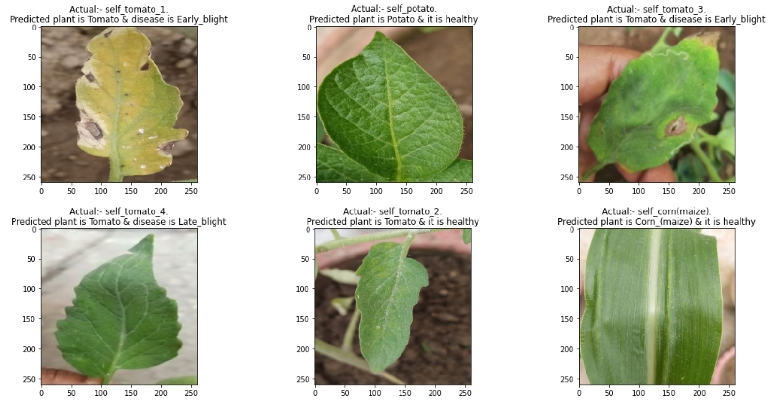
More results of predictions of DL model on real world images

